Slide 1
Battle of neighborhoods.
Finding an apartment in New York City.

Slide 2
New York vs pune
The project is about finding a an apartment in New York city. The apartment should be in a neighborhood which is similar to the neighborhood named ‘Viman nagar’ in the city of Pune-India.
The project consists of using python programming, foursquare data, jupyter notebooks, Watson studios, csv files and github.
Project involved data cleansing, data mining, analyzing with the help of k means clustering, mapping and visualizations.

Slide 3
The tools described are used here and the Notebook cells indicates the execution of steps.
1.City of Pune is analyzed as it would be the reference point in selecting a neighborhood in New York.
2.Coordinates of Pune are found using geolocator and the neighborhood ‘VimanNagar’ is mapped for reference using Foursquare data.
3.Venues are classified using Foursquare data.
4. Manhattan Neighborhood data is analyzed and mapped.
5. Manhattan Boroughs are clustered.
6. A map of Manhattan is shown with top 10 clusters using Folium.
7. A map of Manhattan is shown with places for rent.
8. Statistics of rent prices are shown with the help of matpotlib using box plots and graphs.
9. Clustering is done using the method of k- means clustering.
10. Sub way locations are mapped.
11. Finally a consolidated map is shown consisting of rental places, subway stations and cluster of venues.
12. Apartment is selected basis the above requirements.

Slide 4
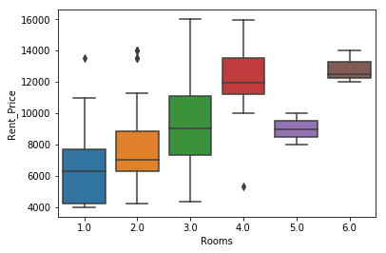
Rooms vs rent prices
This is a box plot made with the help of seaborn library in python.
It shows the apartment with the number of rooms and their particular price ranges for rentals.
This is very useful in making a decision of selecting an apartment as we can see that we have multiple options in 1 Bedroom apartments.

Slide 5
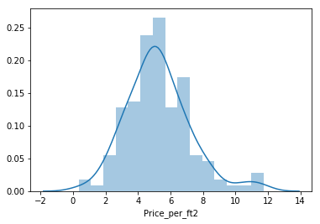
Price per square feet.
This plot shows the comparison of price of the apartment per square feet.
This plot was made by using the data of rent prices in Manhattan.
This visualization gives a clearer picture and makes the work of the data scientist easier.

Slide 6
Conclusions
In this project we were able to delude the following conclusions-
Built useful models to analyze, cluster, cleanse and choose suitable living options.
Used geo graphs and other forms of visualizations to analyze large amounts of data.
Compared two cities that are located in 2 different continents and are culturally and infrastructure vise very different. Despite this difference we were able to find similarities in the neighborhoods
Analyzed geographical, physical and financial data within the same project.
Project is useful to all sorts of people and not limited to professionals.
Project won’t get outdated as people will always immigrate to a different city.

Slide 7
Thank you.
Sonal Rahul Jain.

